Slide 1
Sprocket Customers
KPMG Data Analytics Virtual Internship

Slide 2
Data Insights and Presentation Task
Please develop a dashboard that we can present to the client at our next meeting. Display your data summary and results of the analysis in a dashboard (see tools/references for assistance). Maximum of 3 dashboard views/tabs, creativity in layout and presentation is welcome.
It is important to keep in mind the business context when presenting your findings:
What are the trends in the underlying data?
Which customer segment has the highest customer value?
What do you propose should be Sprocket Central Pty Ltd ’s marketing and growth strategy?
What additional external datasets may be useful to obtain greater insights into customer preferences and propensity to purchase the products?
Specifically, your presentation should specify who Sprocket Central Pty Ltd.'s marketing team should be targeting out of the new 1000 customer list as well as the broader market segment to reach out to.

Slide 3
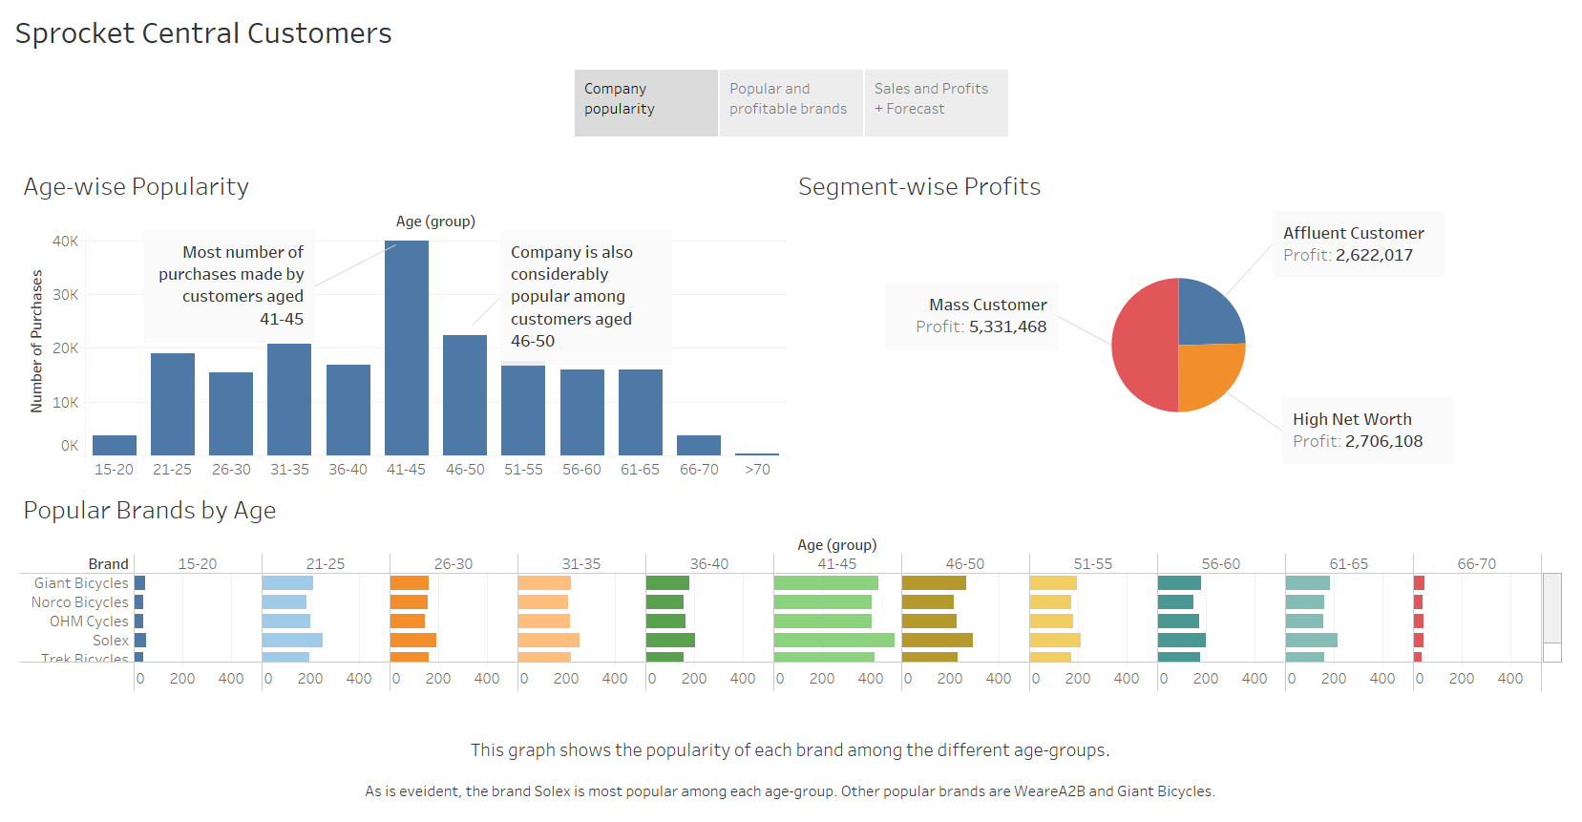

Slide 4
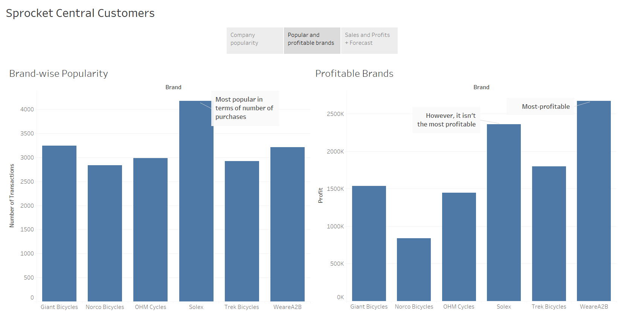

Slide 5
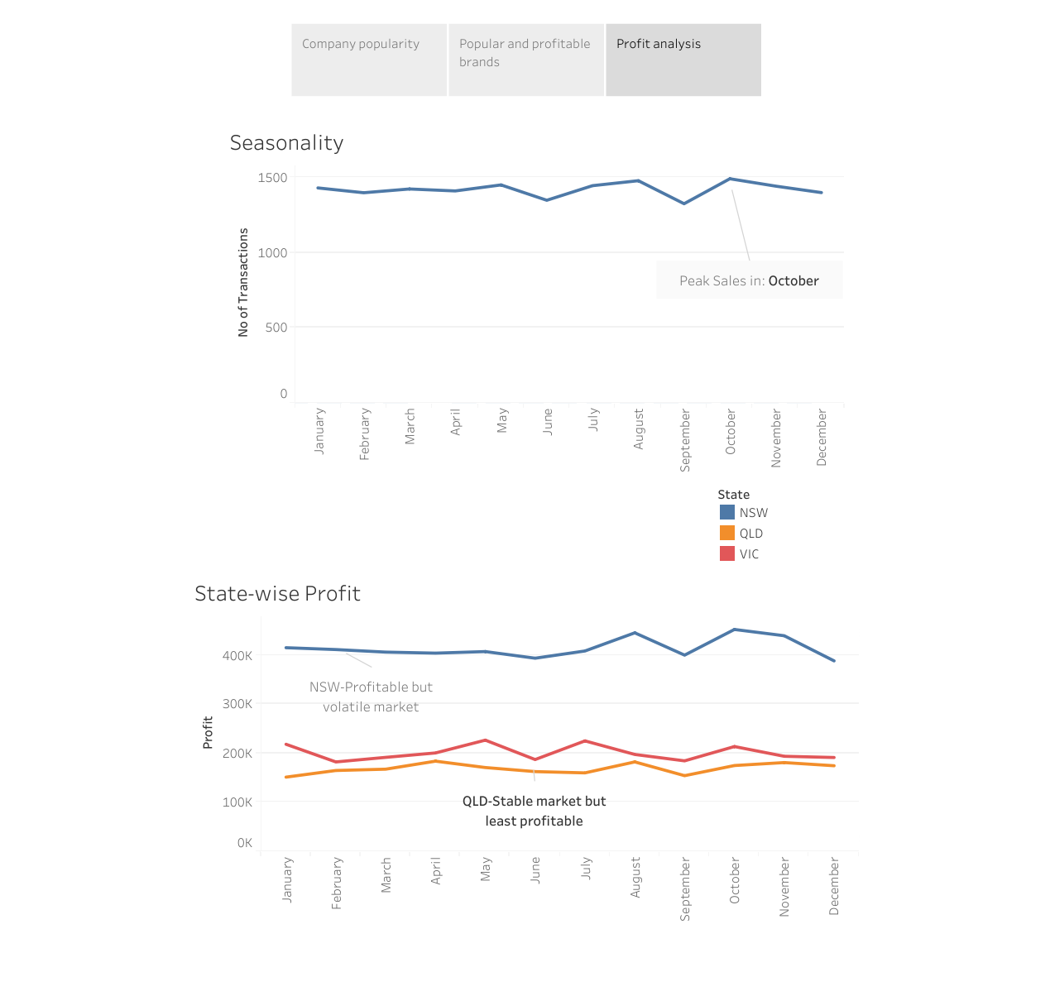

Slide 6
Growth Strategy
This presentation has highlighted the underlying trends in the company’s customer and transactions database.
Based on the uncovered trends and facts, the following strategy is recommended for the growth of the company:
Mass customers aged 41-50 to be targeted
Brands “Solex”, “WeareA2B” and “Giant Bicycles” to be promoted more.
Profit margin for products of the brand “Solex” to be increased.
Business should focus more on the customer from NSW.

